Slide 1
Adding Utilities to your SQLPathFinder Query
(view in slide show mode)

Slide 2
This presentation describes how you can add basic utilities to your SQLPathFinder query

Slide 3
Agenda
Introduction
Adding Utilities
Utility Tips

Slide 4
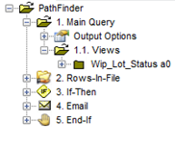
Introduction to Utilities
Data extraction is of limited value unless you can convert data to information, present and distribute it
SQLPathFinder helps you string together a flow of queries and utilities into an application. E.g.,:
  Extract data,
  Analyze using JMP,
  Publish results via email
Sample utilities include ➔
  File management: (Copy, Delete, Rename, ZIP...)
  Conversion: (XML, XLS, CSV, HTML, JMP…)
  Presentation: (HTML, R, JMP, Excel)
  Distribution: (e-mail, SharePoint, HTML)
  Logic flow: (RowsInFile, AgeOfFile, If-Then)
  Iteration: (Run-Loop, Site-Loop, For-Loop)
  Efficiency: (Smart-Append, Get-Site-Time..)
  Work outside box: (SQL ..)
Notes:
SPF includes a large number of "utilities" which cover all key aspects of application development:
File management (Copy, Rename, Delete, Wait-for-File, ZIP/UNZIP)
Data format conversion (XML-to-CSV, XLS-to-CSV, CSV-to-XML, CSV-to-HTML, CSV to XLS (Excel), CSV to JMP (JMP))
Presentation quality output (HTML Report, Chart-in-JMP, R, JMP, Excel)
Output distribution (e-mail, SharePoint, HTML)
Logic flow (RowsInFile, AgeOfFile, If-Then)
Iteration (Run-Loop, Site-Loop, For-Loop)
Automated self-customization (Several kinds of macros, IN TEMP filters, pivoting)
Minimizing resource consumption for large queries (Append, Smart-Append, Get-Site-Time, Update-Time)
When all else fails, letting users work outside the box (Raw SQL, DOS)

Slide 5
Agenda
Introduction
Adding Utilities
Utility Tips

Slide 6
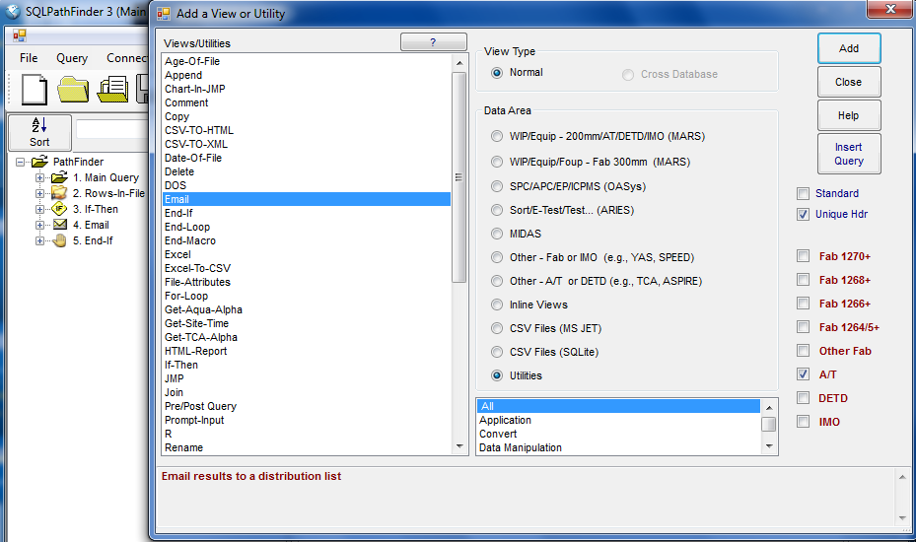
Adding Utilities
To add a utility, select Data Area Utilities on the Add a View or Utility form
Double-click a utility to add it to your query
Drag-and-drop utility to position it. Double-click utility to configure it (Add View or Utility form should be closed)

Slide 7
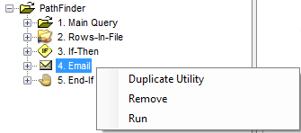
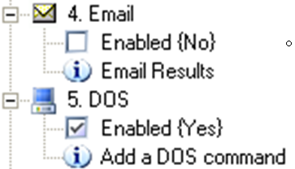
Adding Utilities
You can Enable or Disable a utility step
You can add a utility comment that is written to the log
You can “right-click” a utility to run it or duplicate it
Disabled
Enabled
Comment

Slide 8
Agenda
Introduction
Adding Utilities
Utility Tips

Slide 9
File Movement Utilities
Use Copy, Rename or RoboCopy Utilities to move files
  SQLite generally accesses files in your work folder. You may need to copy files into folder at job start
  Faster to do work in work folder, and then copy results to destination share at end of job
  Use RoboCopy to copy large files as it will retry copies if there is a network glitch
  Rename removes original file if file is copied across folders. It can also add date tokens to file. E.g.,
    <ww> - work week
    <TS> - Timestamp

Slide 10
Distribution Utilities
Some utilities let you distribute output
  Sharepoint lets you publish output to a site
  Email lets you email results to a distribution
    The distribution list can be a coma delimited list of email addresses or a file containing addresses
    You can optionally require addresses to be part of specific Rialto roles (e.g., 1272_MAOData)

Slide 11
Reporting/Analysis Utilities
Excel lets you load data to Excel & run a macro
JMP lets you load data to JMP or run a JSL script
HTML-Report lets you generate reports or charts
Chart-in-JMP helps you build a JMP program without knowing JSL
  Wait-File waits for a file to appear or a period of time to expire.
    Use with JMP or Chart-In-JMP if you need to wait for JMP to create a file before going onto the next query step, as JMP passes control to next step even if JMP is still in process

Slide 12
Conditional Execution Utilities
The Value-In-File, Rows-In-File, and Age-of-File utilities add data to a variable at run-time
  Rows-In-File – Gets number of rows in file
  Value-In-File – Gets column value in first row of file
  Age-Of-File – Gets age of file
Use the IF-Then utility to test for these values and perform conditional processing

Slide 13
Conditional Execution
Example
Extract
Data
Count rows
in file
If
Rows
>0
N
Utility If-Then optionally executes steps depending on conditions such as the number of rows in a file
  E.g., run query & email a distribution if any lots are on hold
Y
Email
File
End

Slide 14
That concludes the presentation
on basic utilities

